Slide 1
Linux Installation
Zachary Guillory

Slide 2
Motivation
Familiarity with Linux often appears on internship and job description requirements for my field
In researching my project for Hardware, I learned Linux has many benefits over traditional operating systems

Slide 3
Objectives
Install Linux on an old computer
Familiarize myself with a Linux operating system and basic terminal commands

Slide 4
Hardware
Hp Laptop
Intel Pentium
4 GB ram
Windows 11 loaded

Slide 5
Why Linux Mint?
Linux Mint is easy to transition to for Windows users
Linux Mint has user-friendly interface
Linux Mint is a stable distro

Slide 6
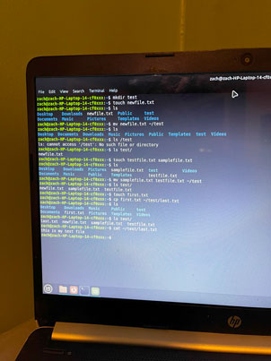
Demo

Slide 7
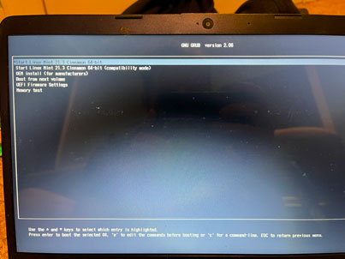
What Went Wrong
Installing Linux was more difficult than I imagined
The terminal is unforgiving with syntax

Slide 8
What Went Right
Once you learn the commands, it is simple
Linux Mint’s user interface was as user-friendly as described

Slide 9
Conclusion
Mint is a viable option as an OS, to the point I am considering switching on my next computer

Slide 10
References
Linux Mint Installation Guide. (2017). Linux Mint. Retrieved April 1, 2024, from https://linuxmint-installation-guide.readthedocs.io/en/latest/install.html
Smith, R. (2012). Linux Essentials. John Wiley & Sons.

